Slide 1
Digital IC Design Final project

Slide 2
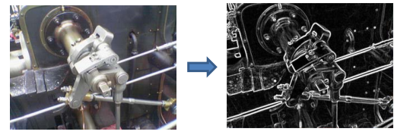
Design Description
The Sobel operator, sometimes called the Sobel–Feldman operator or Sobel filter, is used in image processing and computer vision, particularly within edge detection algorithms where it creates an image emphasising edges.

Slide 3
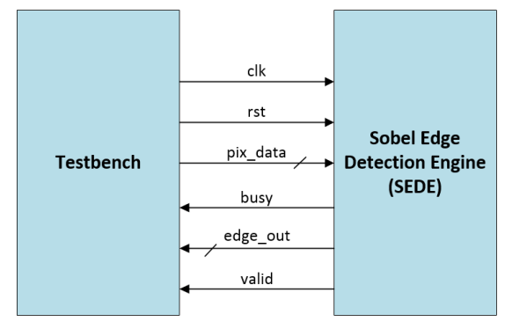
Block Diagram & Specifications
Top module name : SEDE (File name: SEDE.v).
Input ports: pix_data[7:0], clk, rst .
Output ports: edge_out[7:0], valid, busy.
Note：All the outputs are synchronized at clock positive edge. It is asynchronous-reset architecture.

Slide 4
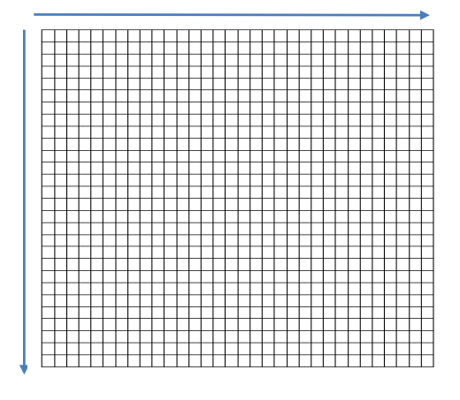
Functionality
The size of input image is 32 × 32. After the reset is completed, the testbench will input the entire image sequentially. The order of the input image is from left to right, from top to bottom as shown in the figure below.

Slide 5
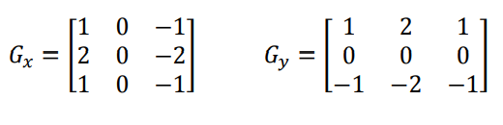
Computation steps
Select any pixel in the image and draw a 3 × 3 window with this pixel as the center.
Each pixel in the window is convolved with the sobel operator (Gx,Gy). That is, the pixel value in the window is multiplied by the corresponding value in the sobel operator. And then, accumulate the product of each pixel. The answer is the gradient of the pixel in a certain direction.
After calculating the gradients in the X and Y directions, add the two gradients and divide by two(round down to an integer), (gradientX + gradientY)/2, you will get the final answer (edge_out).

Slide 6
Computation note
The output order of the processed image is also from left to right, from top to bottom. That is same as the order of input. And When you are outputting the result (edge_out), the valid signal also need to be pulled up (set to 1) at the same time.
The busy signal is used to control the input data flow. When the busy signal is 0, the output data will be continuously input at each posedge clock. And when the busy signal is 1, the input data will be suspended until busy signal is set to 0 again.
When the final answer is more than 255, it will be output as 255. If it is less than 0, it will be output as 0.
When performing edge detection processing. The leftmost , rightmost , top , bottom lines of the image do not need to be processed, so their output value (edge_out) are 0.

Slide 7
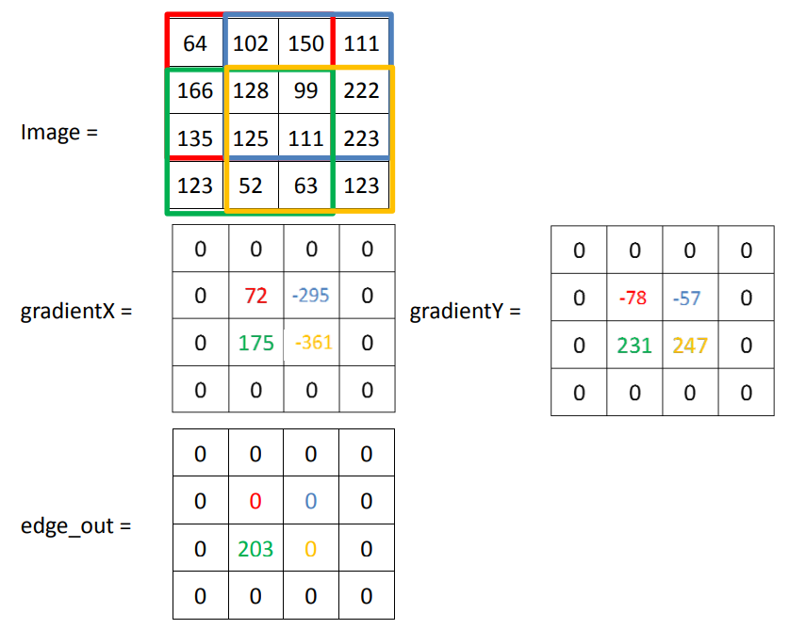
Computation example
Ex:

Slide 8
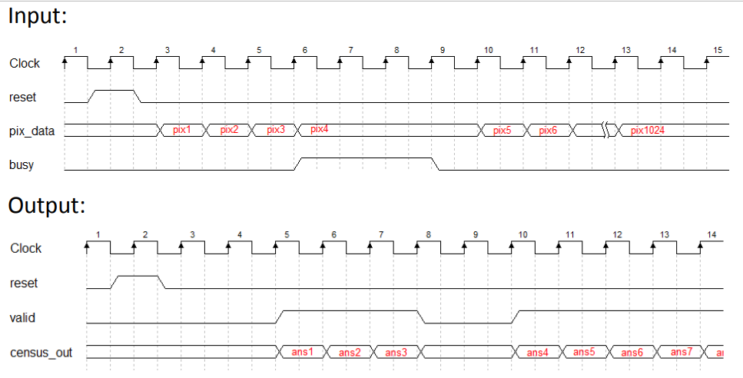
Waveform
Signal | Behavior
busy | control the input data flow
valid | enable the output signal (census_out), (active high)

Slide 9
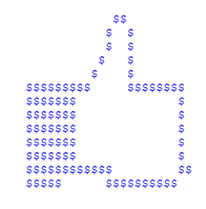
Verification & Score
本作業提供測試程式(testbench)，SEDE.v 需能通過 testbench 的驗證並依照完成程度計分，另外這次 Project 只需 RTL 模擬與合成不需要上板子與demo 。
通過驗證後會出現右圖，若沒出現可以嘗試按run all。
評分標準為下
等級 | 成績 | 等級標準
A | 25~20 | 為完成所有測試樣本之 RTL simulation 且電路可合成，並依照合成後的 「Flip-Flop 數量 X 完成 testbech 所花費的 Cycle 數」來細分成績
B | 17 | 為完成所有測試樣本之 RTL simulation 但電路無法合成
C | 15~10 | 為完成測試樣本 50%以上(含)之 RTL simulation ， 並依照通過測試樣本的比例來細分成績
D | 7 | 為完成測試樣本 50%以下之 RTL simulation

Slide 10
繳交項目與注意事項
各組將寫好的 SEDE.V 以及書面報告壓縮成一個檔案後由組長上傳至 moodle，不接受遲交。
書面報告(report.pdf)需包含：
設計原理 ( 可以描述如何設計狀態機、儲存資料的方式或運算時如何設計使電路花費較少的Flip-Flop與cycle數)
通過測試的截圖
各組員分工內容與貢獻度
嚴禁抄襲，抓到將以零分計算
上傳截止日期: 2023/1/5(四) 23:59

